Slide 1
AMAZON REVIEW ANALYSIS
Project by
Priyanka Malla & Ansuya Patel

Slide 2

CONTENTS
Problem Description
Data Description
Dataset Description
Data Exploration
Data Preprocessing
Model Building
Model Performance
Conclusion
Improvements

Slide 3
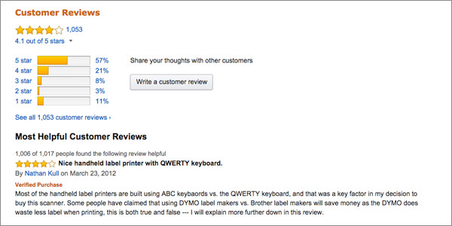
Problem Description
Is it possible to predict the star rating of an Amazon review given the text of that review? We want to try to answer that question using a collection of 400,000 Amazon reviews of unlocked mobile phones as my dataset.

Slide 4
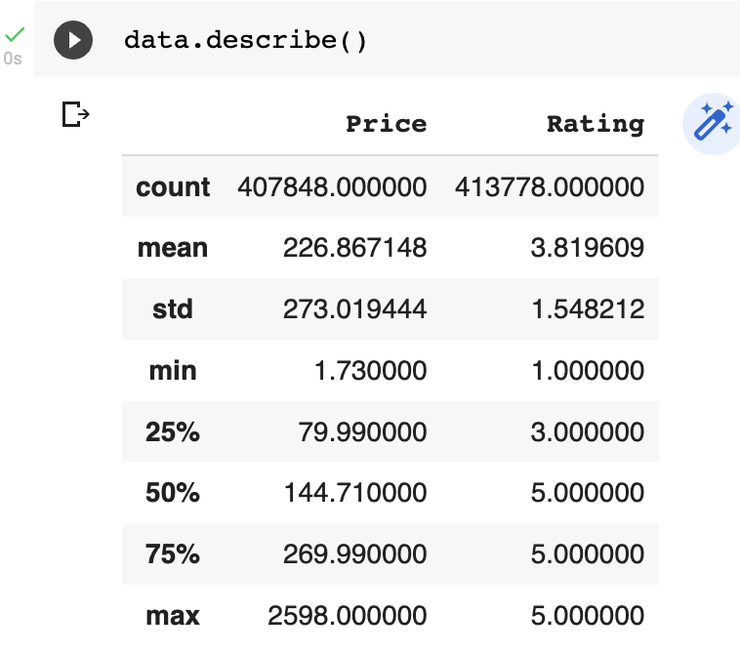
Data Description
We have almost 400000 items in the dataset that we used to perform data analysis.
Here is the data description of the dataset that we used.

Slide 5
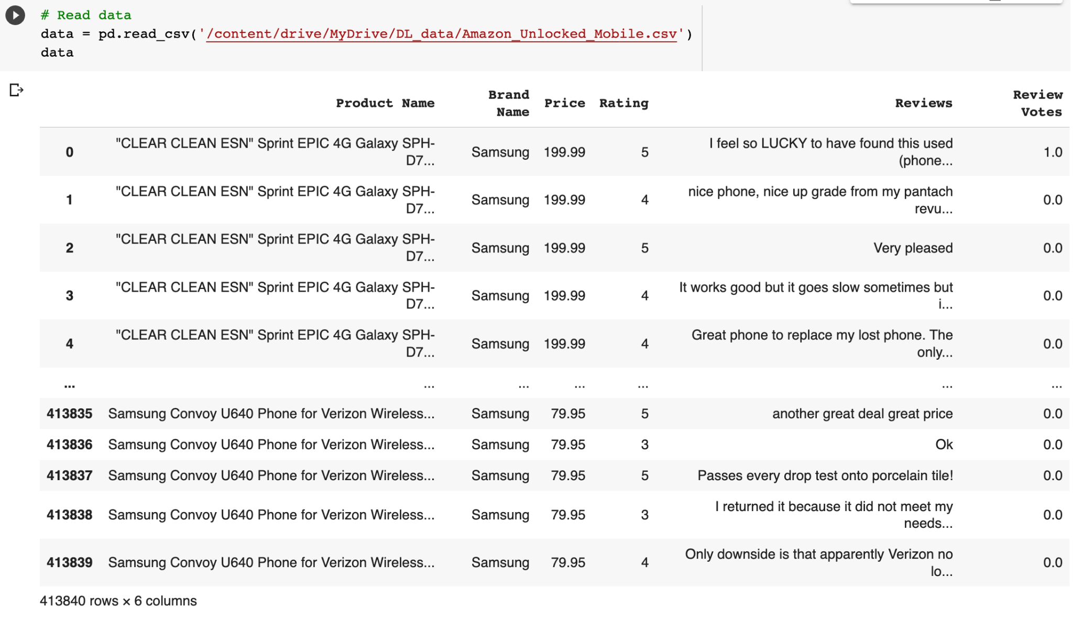
Dataset Description
Metric Description_________
Product Name Name of The Product
Brand Name Manufacturer of the Product
Price Price of the Product
Rating Rating Given for the product
Reviews Review left by the Customer
Review Votes Number of People who found
the Review Helpful

Slide 6
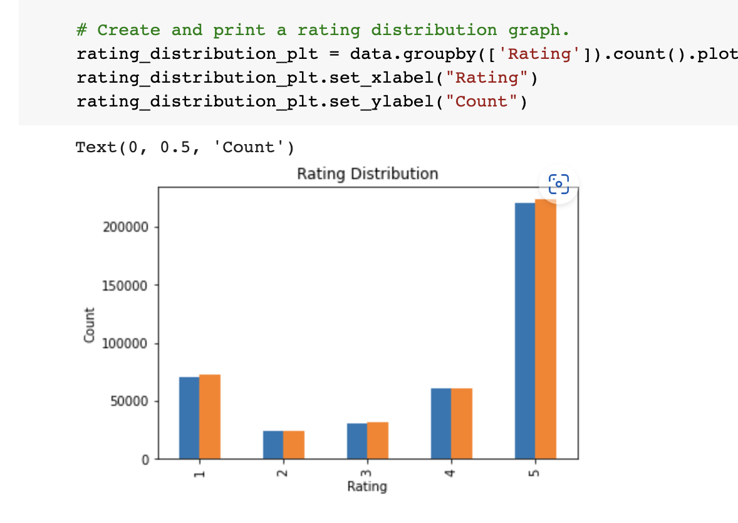
Data Exploration
This is a Histogram graph, which plots pictographic representation of number of reviews of each rating.

Slide 7
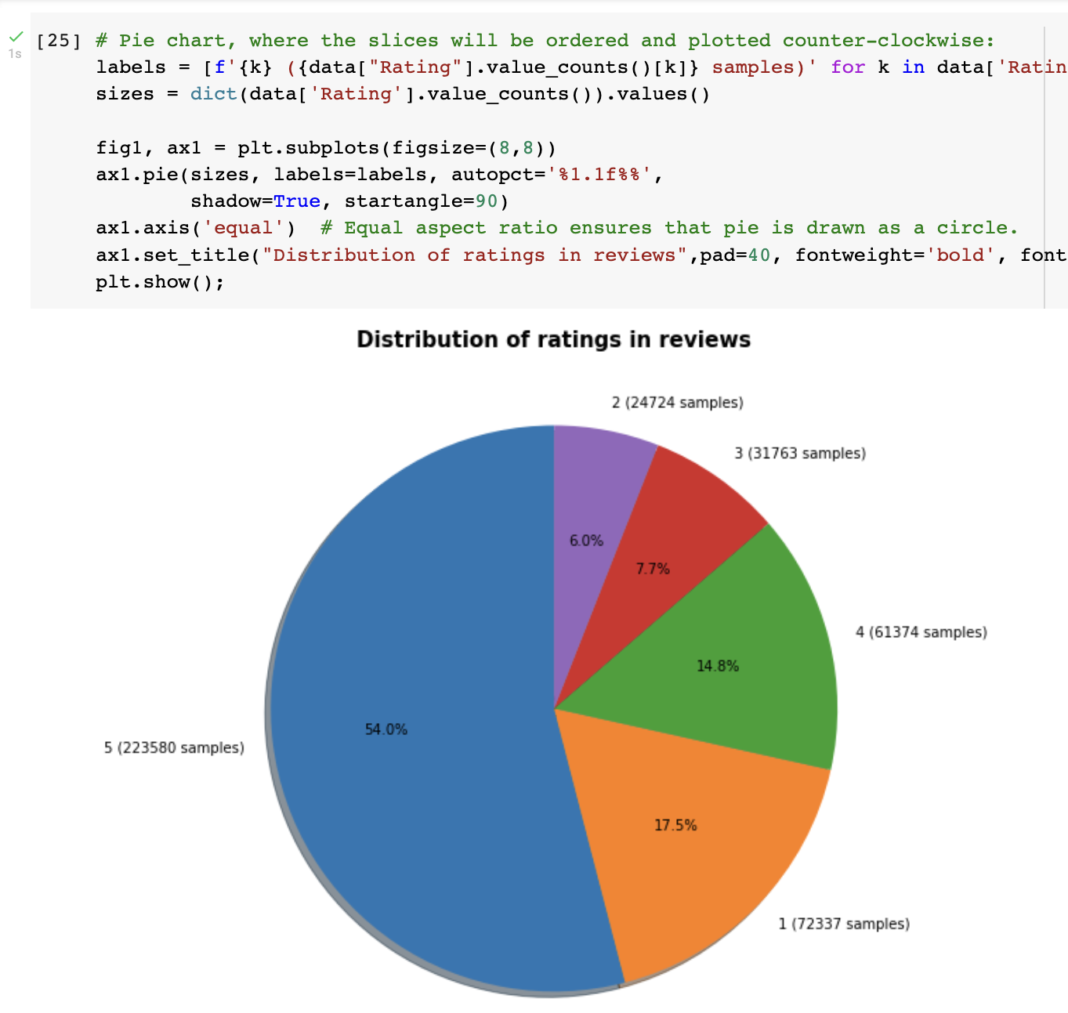
Data Exploration
Here is the plot for the pie chart, that represents the distribution of the ratings in the reivews

Slide 8
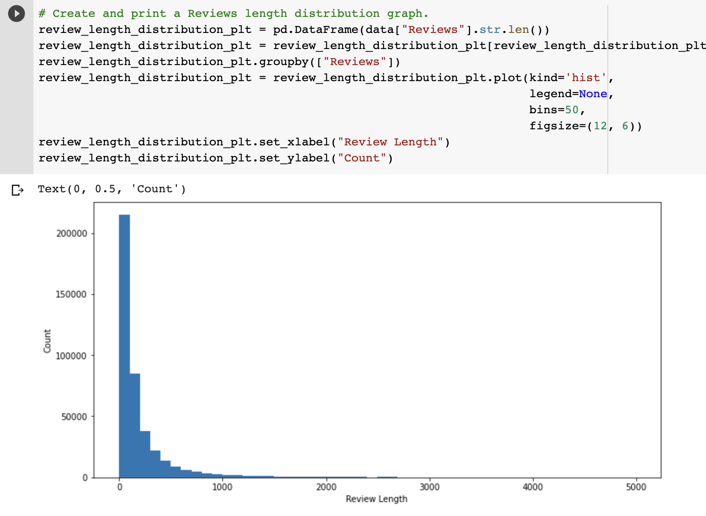
Data Exploration
Here is another histogram graph, that determines the plot of length of the review in each comments in all the reviews.

Slide 9
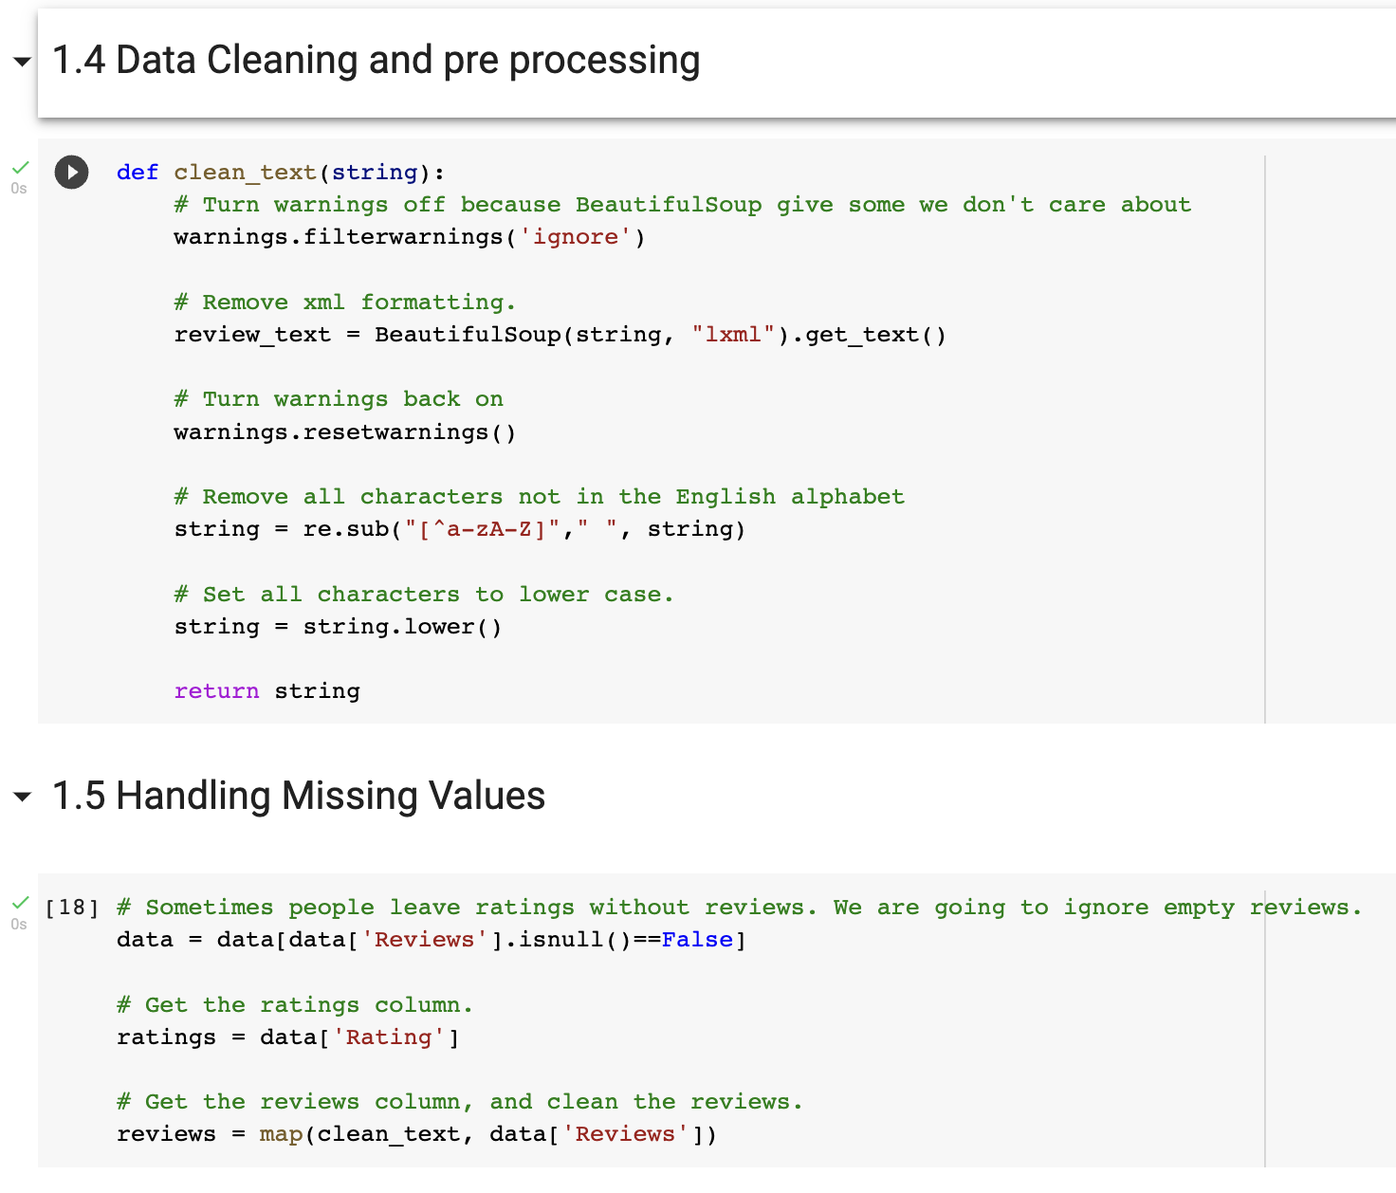
Data Preprocessing
Turn warnings off because words like “besst” give some we don't care about.
Remove xml formatting.
Remove all characters not in the English alphabet.
Set all characters to lowercase.

Slide 10
Data Preprocessing
Sometimes people leave ratings without reviews. So it is better to ignore empty reviews.
Get the ratings column.
Get the reviews column, and clean the reviews.

Slide 11
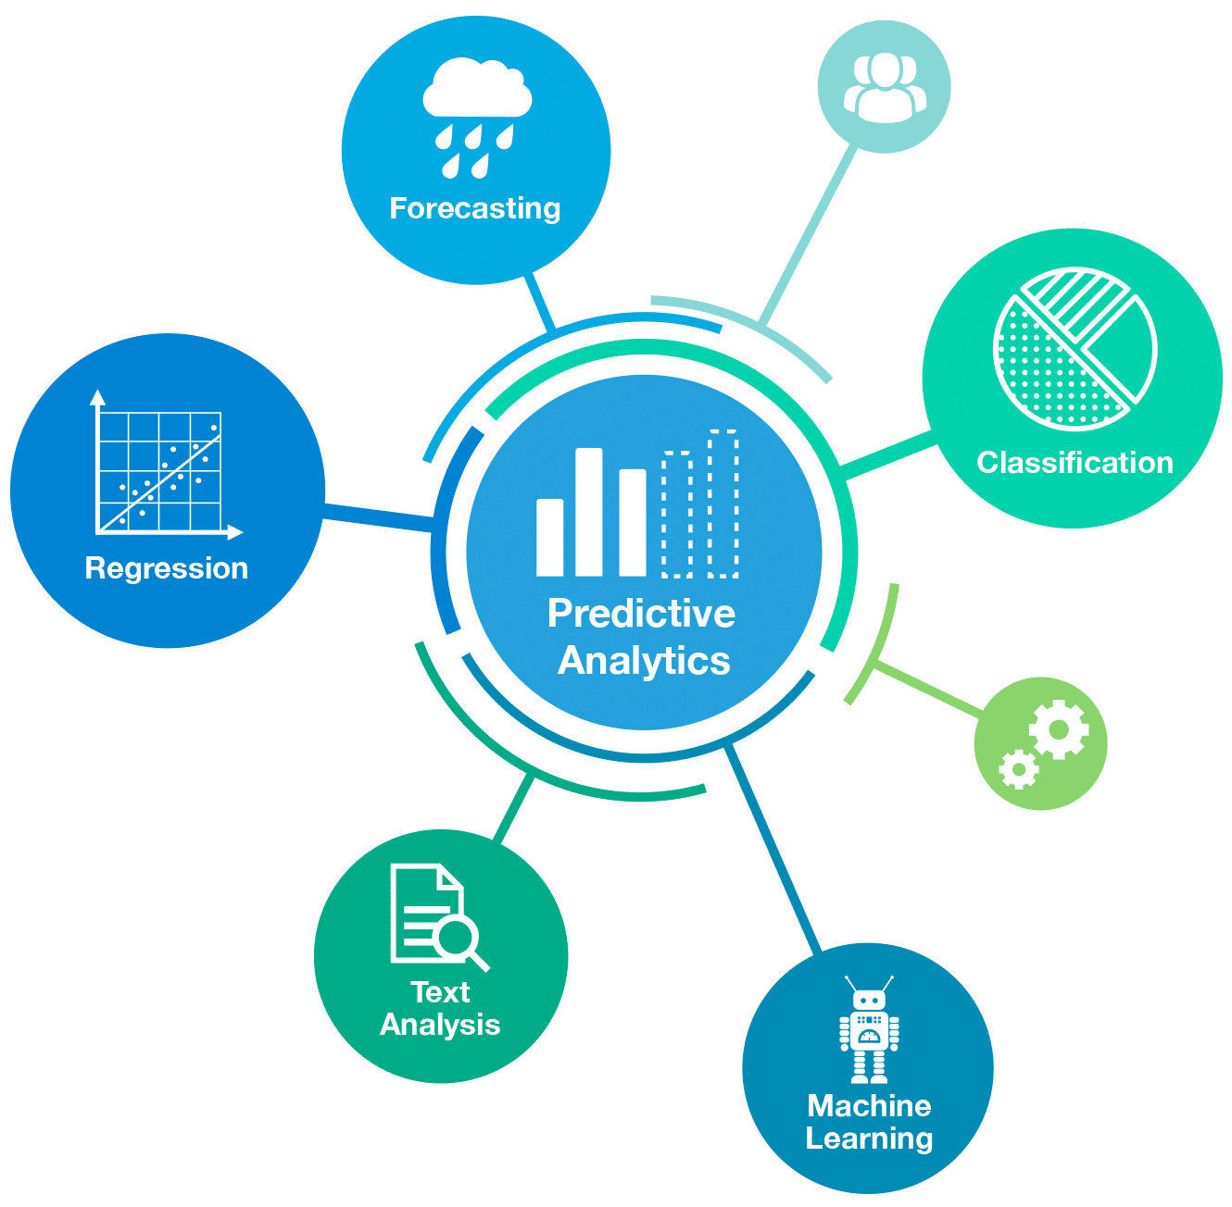
Model Building
We used two models in particular to analyse the dataset to predict the star rating of an Amazon review that is given in form of comment or text.
Logistic Regression
Multinomial Naive bayes

Slide 12
Logistic Regression
Logistic regression is the appropriate regression analysis to conduct when the dependent variable is binary.
Like all regression analyses, the logistic regression is a predictive analysis.
Logistic regression is used to describe data and to explain the relationship between one dependent binary variable and one or more nominal, ordinal, interval or ratio-level independent variables.
Sometimes logistic regressions are difficult to interpret; the Intellectus Statistics tool easily allows you to conduct the analysis, then in plain English interprets the output.

Slide 13
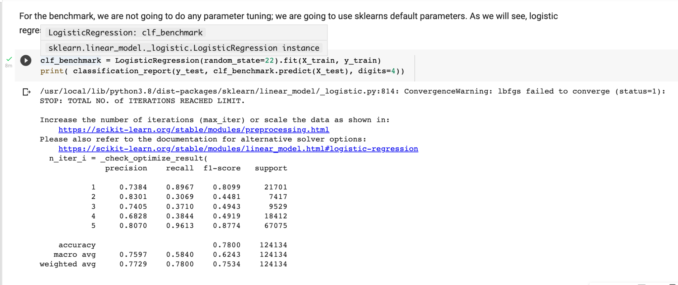
Result of logistic regression before refining data

Slide 14
Multinomial NB classification
Multinomial Naive Bayes classification algorithm tends to be a baseline solution for sentiment analysis task.
The basic idea of Naive Bayes technique is to find the probabilities of classes assigned to texts by using the joint probabilities of words and classes.

Slide 15
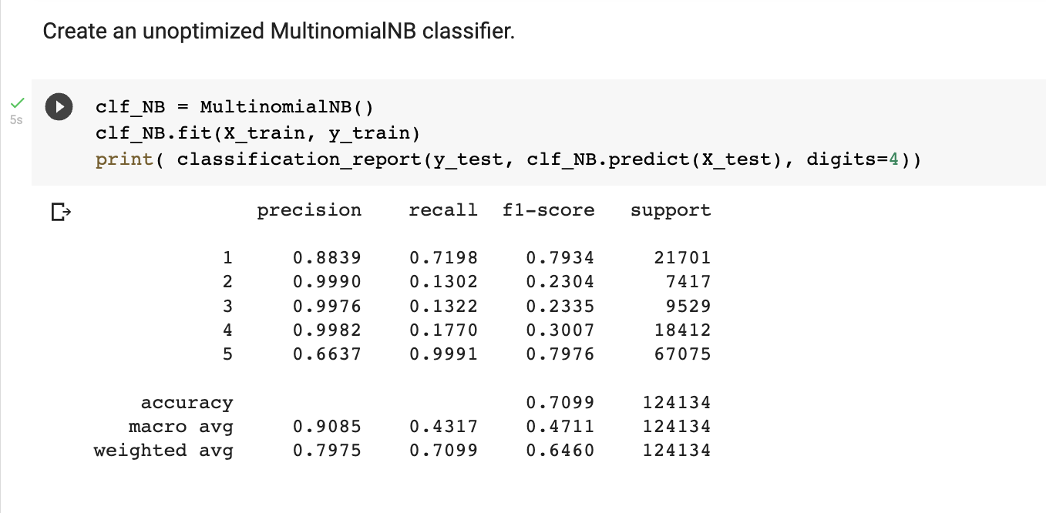
Result of MultinomialNB before refining data

Slide 16
Model Performance

Slide 17
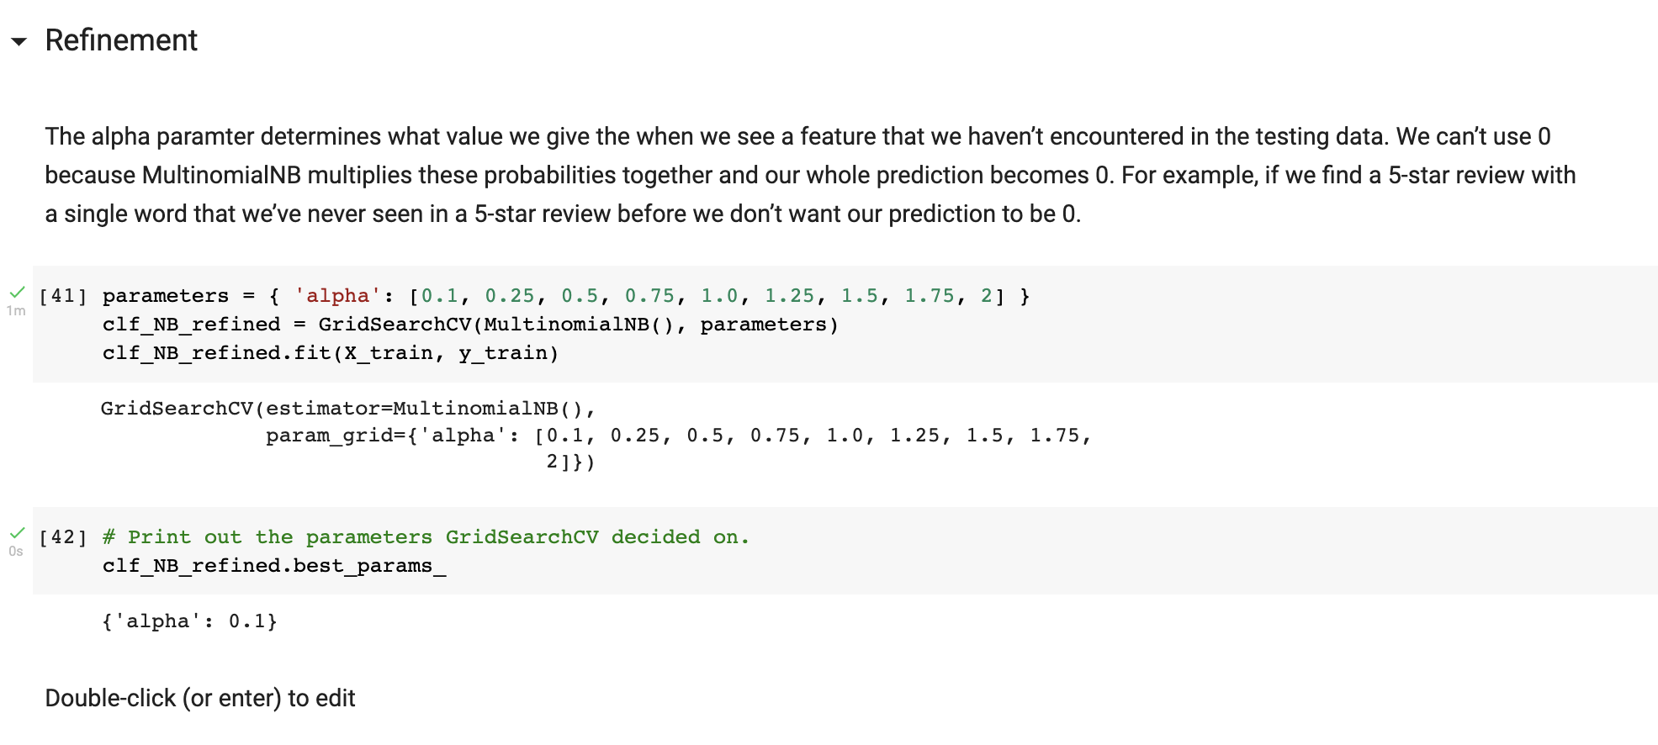
Refining the data set

Slide 18
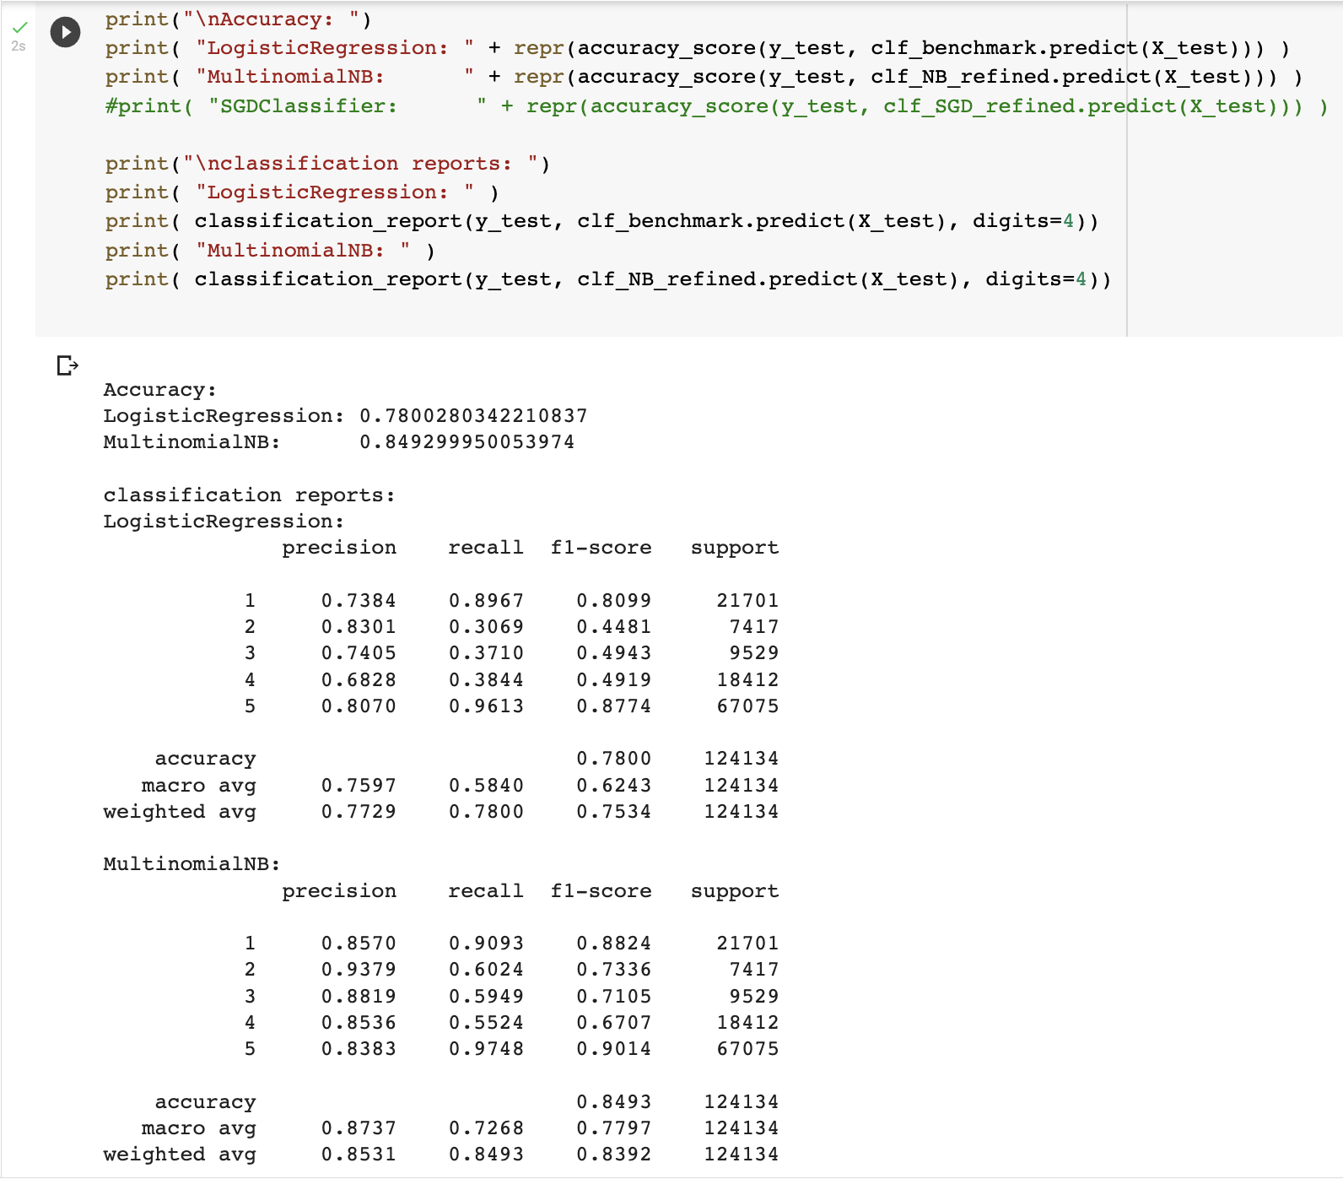
Result after refining the data

Slide 19
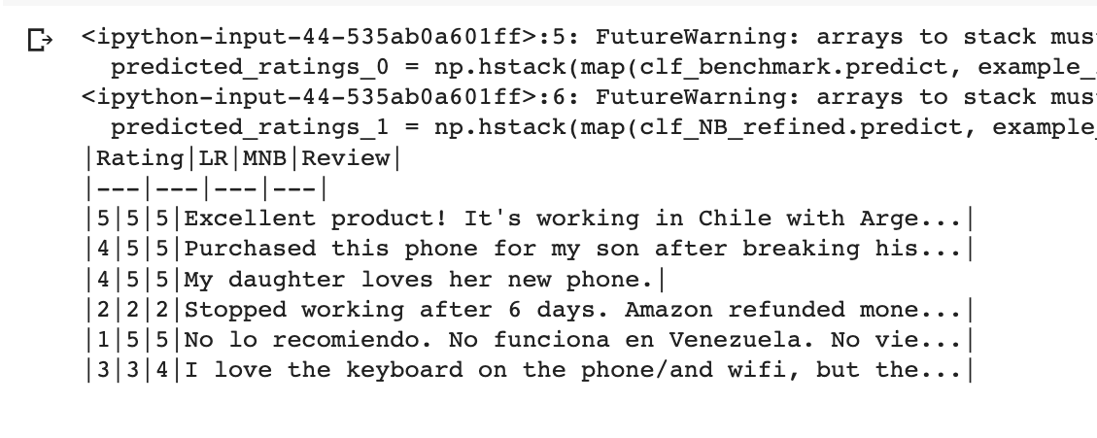
Steps to determine performance on a set of example reviews
Create features on the example reviews.
Predict the reviews with each model.
We don't need to print the whole review out;
just enough to compare to the first table.
Create a table of reviews.
Reorder columns.
Print reviews in a markdown table.

Slide 20
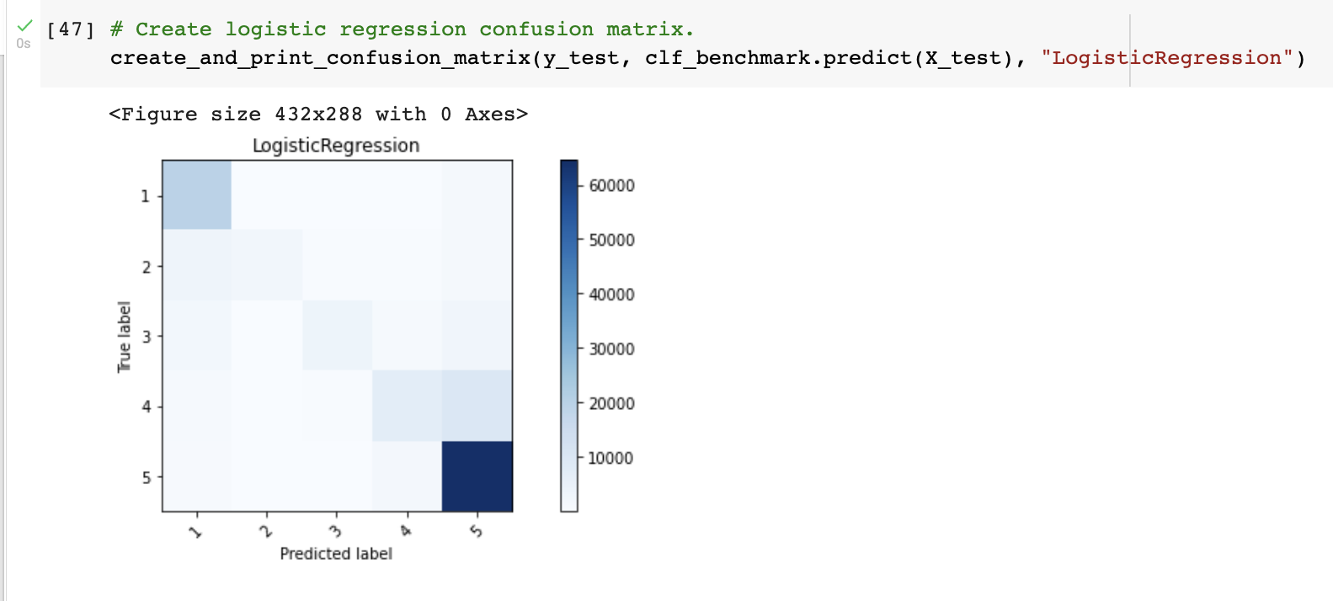
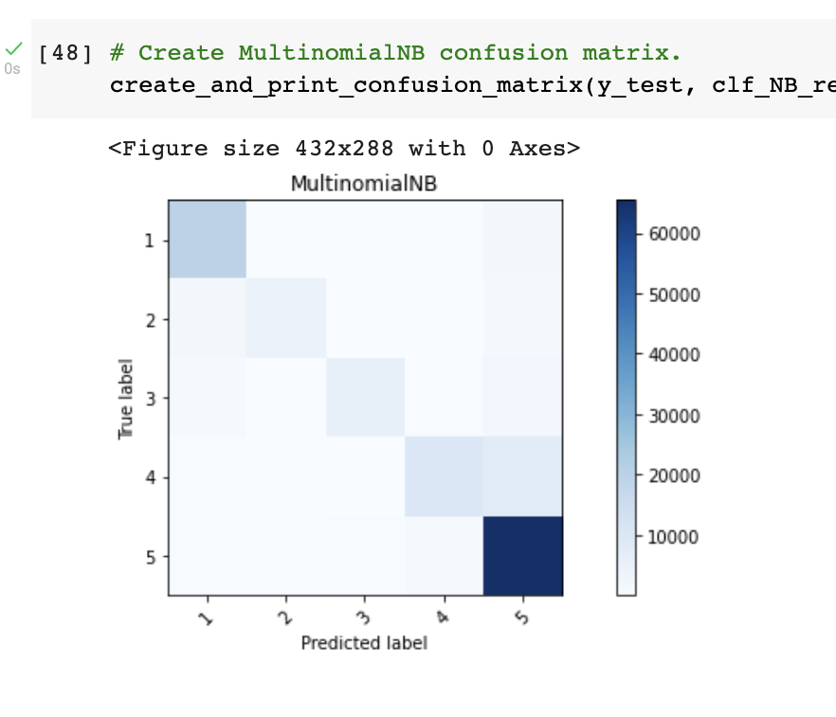
Confusion Matrix

Slide 21
Conclusion
The final MultinomialNB has a F1-Score of 0.8392, this is much better than the benchmark model which has a score of 0.7534.
We can see that the classifiers have a hard time differentiating between 4 and 5 star reviews and 2 and 1 star reviews.
One of the reviews has Spanish words, so it’s not surprising that that both the classifier got that predictions wrong.
The final model does a good job of finding the general sentiment of a review.
To determine if a review is positive or negative, then this model is probably good enough.
To determine a model that can differentiate between similar star ratings (like 3-star and 4-star reviews), then more work needs to be done.

Slide 22
Improvements
All two models have low recall on reviews with star ratings between 2 and 4.
Even for a human, it’s difficult to differentiate between these reviews.
The difference between a 3-star and 4-star review is very subtle.
A good place to look for improvements are ways to improve recall for these mid-star reviews.
A solution not explored in this report is a neural network.
Many people have found success using neural networks for text classification problems.

Slide 23
Questions??
Thankyou!!

